Slide 1
Investigating Bias and Fairness in AI Models for Alzheimer’s Diagnosis Using OASIS-2 Dataset
BMEN619.03
Reproducible and Responsible AI
Mansi Singhal (30235170)
M.Sc. in Biomedical Engineering
11th April 2025

Slide 2
Topic to be discovered
Introduction
Motivation
Workflow
Dataset Exploration
Dataset Preprocessing
Machine Learning Models
Fairness Evaluation Metrics
Explainability Analysis by SHAP
Results
Responsible AI consideration
Conclusion
References
ChatGPT usage

Slide 3
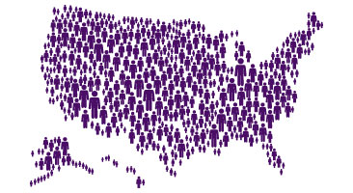
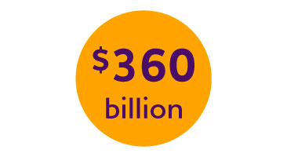
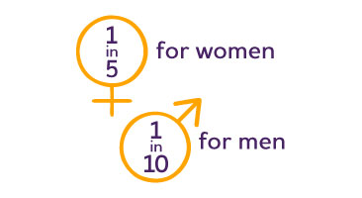
Introduction
According to Alzheimer Society¹
65 million+ people have dementia worldwide.
Every year, there are nearly 10 million new cases.
As of 2025, 771,939 Canadians
living with dementia.
Health and long-term care costs for people living with dementia was projected to $360 billion in 2024 and nearly $1 trillion in 2050.
Lifetime risk for Ad at age 45 is 1 in 5 for women and 1 in 10 for men.
70% living with AD are women.
By 2050, over 1 million women in Canada will have dementia.

Slide 4
Dataset Gaps
Table 1. Summary of the Open Access Medical Imaging Alzheimer’s Datasets
S.No. | Dataset | No. of Subjects | Age Range | MRI | Ethnicity | Location
1. | ADNI (Alzheimer’s Disease Neuroimaging Initiative) | ~2,000 | 55–100 | T1, T2, FLAIR, DTI, fMRI | Diverse, primarily North American | USA
2. | AIBL (Australian Imaging, Biomarkers & Lifestyle) | ~1,000 | 60–90 | T1, T2, FLAIR | Predominantly Caucasian | Australia
3. | Oasis (Open Access Series of Imaging Studies) | ~1,000 | 60–90 | T1, T2 | Diverse | USA
4. | NACC (National Alzheimer’s Coordinating Center) | ~30,000 | 50–100 | T1, T2, FLAIR | Diverse | USA
5. | PPMI (Parkinson’s Progression Markers Initiative) | ~1,400 | 40–80 | T1, T2 | Diverse | USA
6. | UK Biobank | ~500,000 | 40–90 | T1, T2 | Predominantly Caucasian | UK
7. | MIRIAD (Minimal Interval Resonance Imaging in Alzheimer’s Disease) | 69 | 60–90 | T1, T2 | Predominantly Caucasian | UK
8. | Harvard Aging Brain Study (HABS) | ~1,000 | 55–90 | T1, T2 | Diverse | USA
9. | GSP (Brain Genomics Superstruct Project) | ~1,000 | 40–90 | T1, T2 | Diverse | USA
10. | MAP (Memory and Aging Project) | ~1,500 | 65–90 | T1, T2, FLAIR | Diverse | USA
11. | LONI (Laboratory of Neuro Imaging) | ~2,000 | 50–90 | T1, T2, DTI, fMRI | Diverse | USA
12. | SMAD (Swiss Multi-center Alzheimer’s Disease Registry) | ~1,000 | 60–85 | T1, T2, FLAIR | Predominantly European | Switzerland
13. | CANDI (Center for Neurodegenerative Disease Imaging) | ~500 | 55–85 | T1, T2, FLAIR | Diverse | USA
14. | HCP (Human Connectome Project) | ~1,200 | 22–35 | T1, T2, DTI, fMRI | Diverse | USA
15. | Rotterdam Study | ~15,000 | 45–100 | T1, T2 | Predominantly European | Netherlands

Slide 5
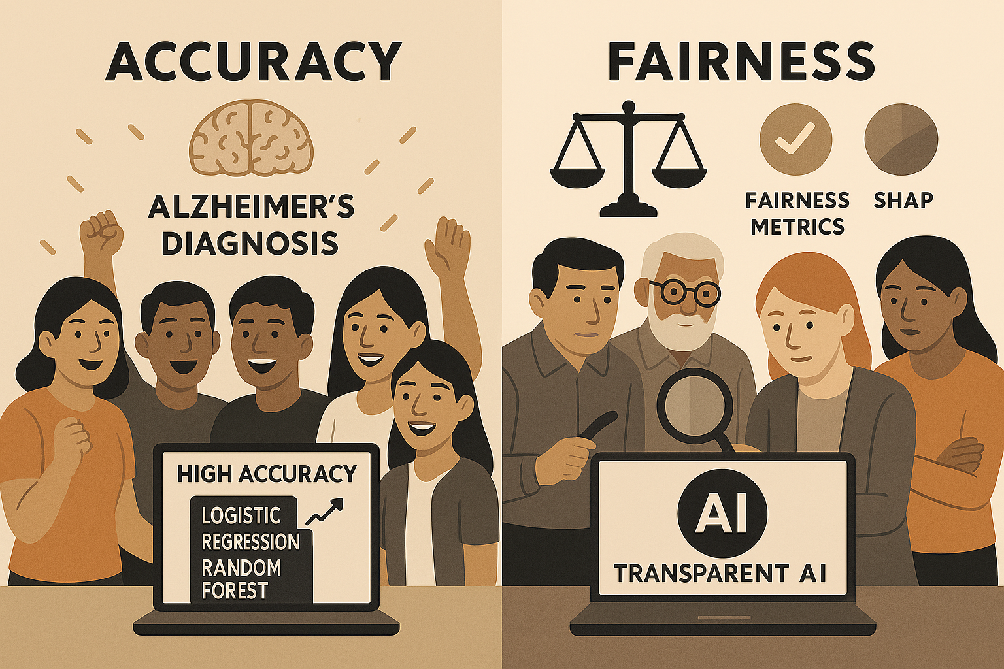
Motivation
ChatGPT output 1

Slide 6
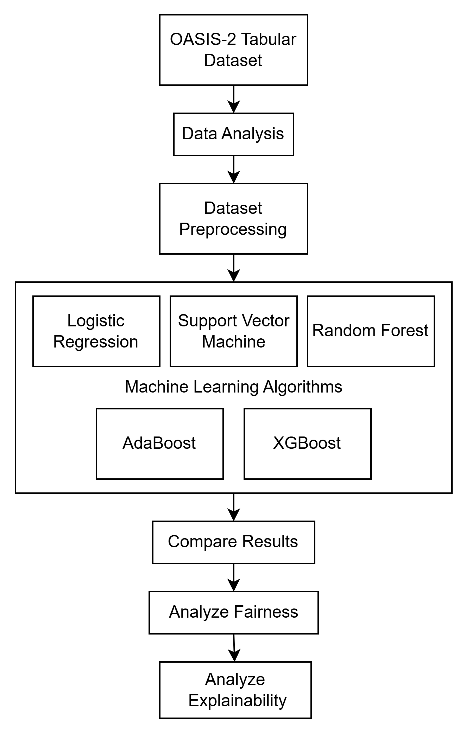
What exactly we are doing?
Q1: Which specific AI model will show to be effective for Alzheimer’s Disease (AD) Diagnosis?
Q2: How do fairness metrics evaluate the AD or classification models?
Q3: How do the decision-making processes of different AI models work when explaining AD?
Q4: What are the challenges and open research directions in AD diagnosing?
Figure. 1. WorkFlow of the project.

Slide 7
Dataset Description
Open Access Series of Imaging Studies subset-2 (OASIS-2) Dataset²
Table 2. Features of OASIS-2 Dataset
Measure | Format | Definition
Age | Integer | Age at time of image acquisition (years)
Sex | Category | Sex (M or F)
Education | Integer | Years of education
SES | Integer | Socioeconomic status as assessed by the Hollingshead Index of Social Position and classified into categories from 1 (highest status) to 5 (lowest status)
MMSE | Integer | Mini-Mental State Examination score (range is from 0 [worst] to 30 [best])
CDR | Float | Clinical Dementia Rating. (0 = no dementia, 0.5 = very mild AD, 1 = mild AD, 2. = moderate AD)
ASF | Float | Atlas scaling factor (unitless). Computed scaling factor that transforms native-space brain and skull to the atlas target (i.e. the determinant of the transform matrix)
eTIV | Float | Estimated total intracranial volume (cm3)
nWBV | Float | Normalized whole brain volume, expressed as a percent of all voxels in the atlas-masked image that are labeled as gray or white matter by the automated tissue segmentation process
Dataset Type: Longitudinal Tabular dataset.
Subjects: Total 373 out of 150 unique Subject IDs
Nondemented: 190 subjects
Demented: 146 subjects
Converted: 37 subjects
Age 60–96
Right-handed
Visits: Each subject has 2–5 MRI sessions.

Slide 8
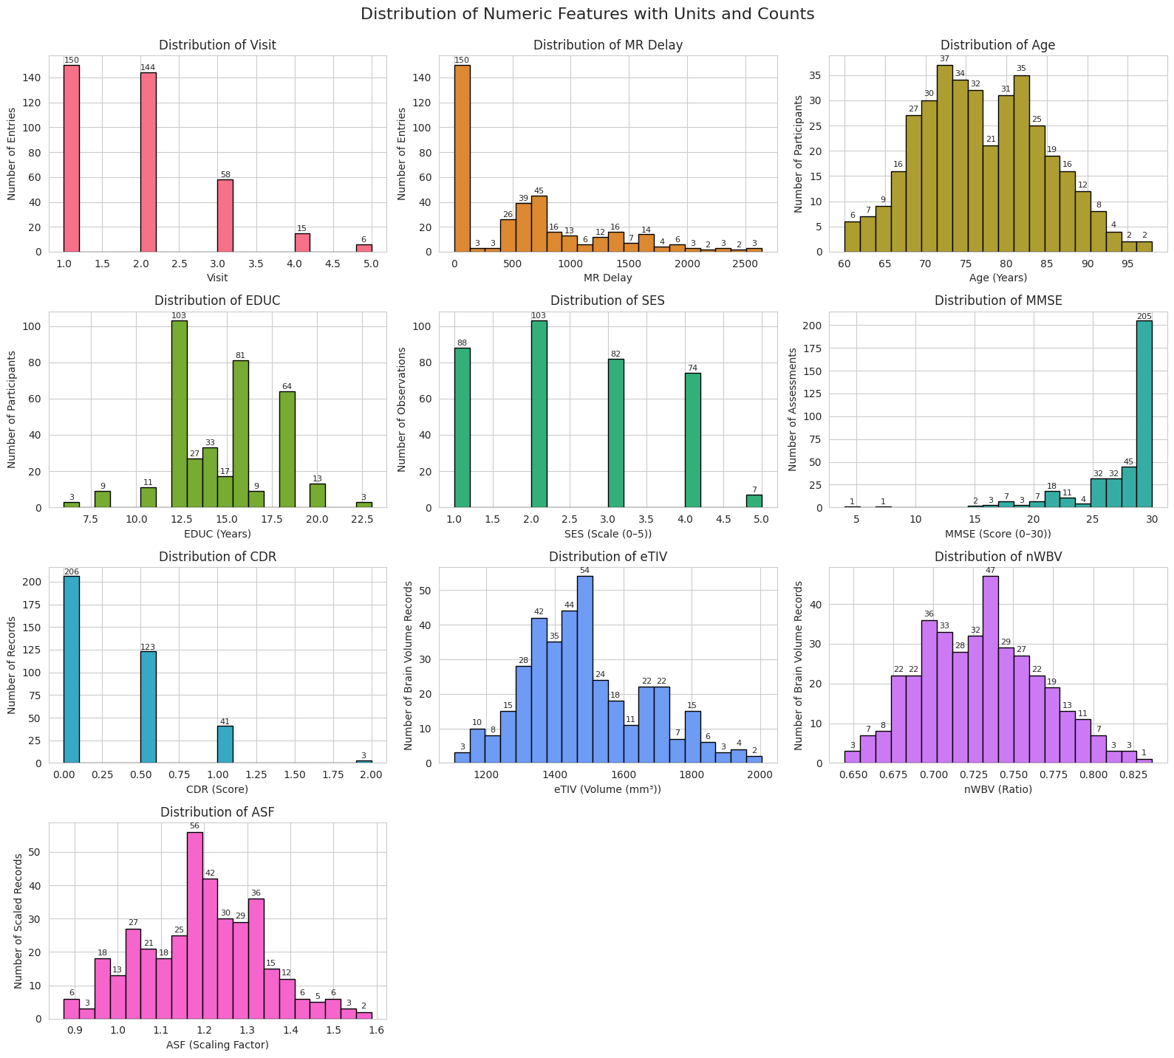
Data Exploration
Figure. 2. Distribution of Numeric Features with Units and Counts.

Slide 9
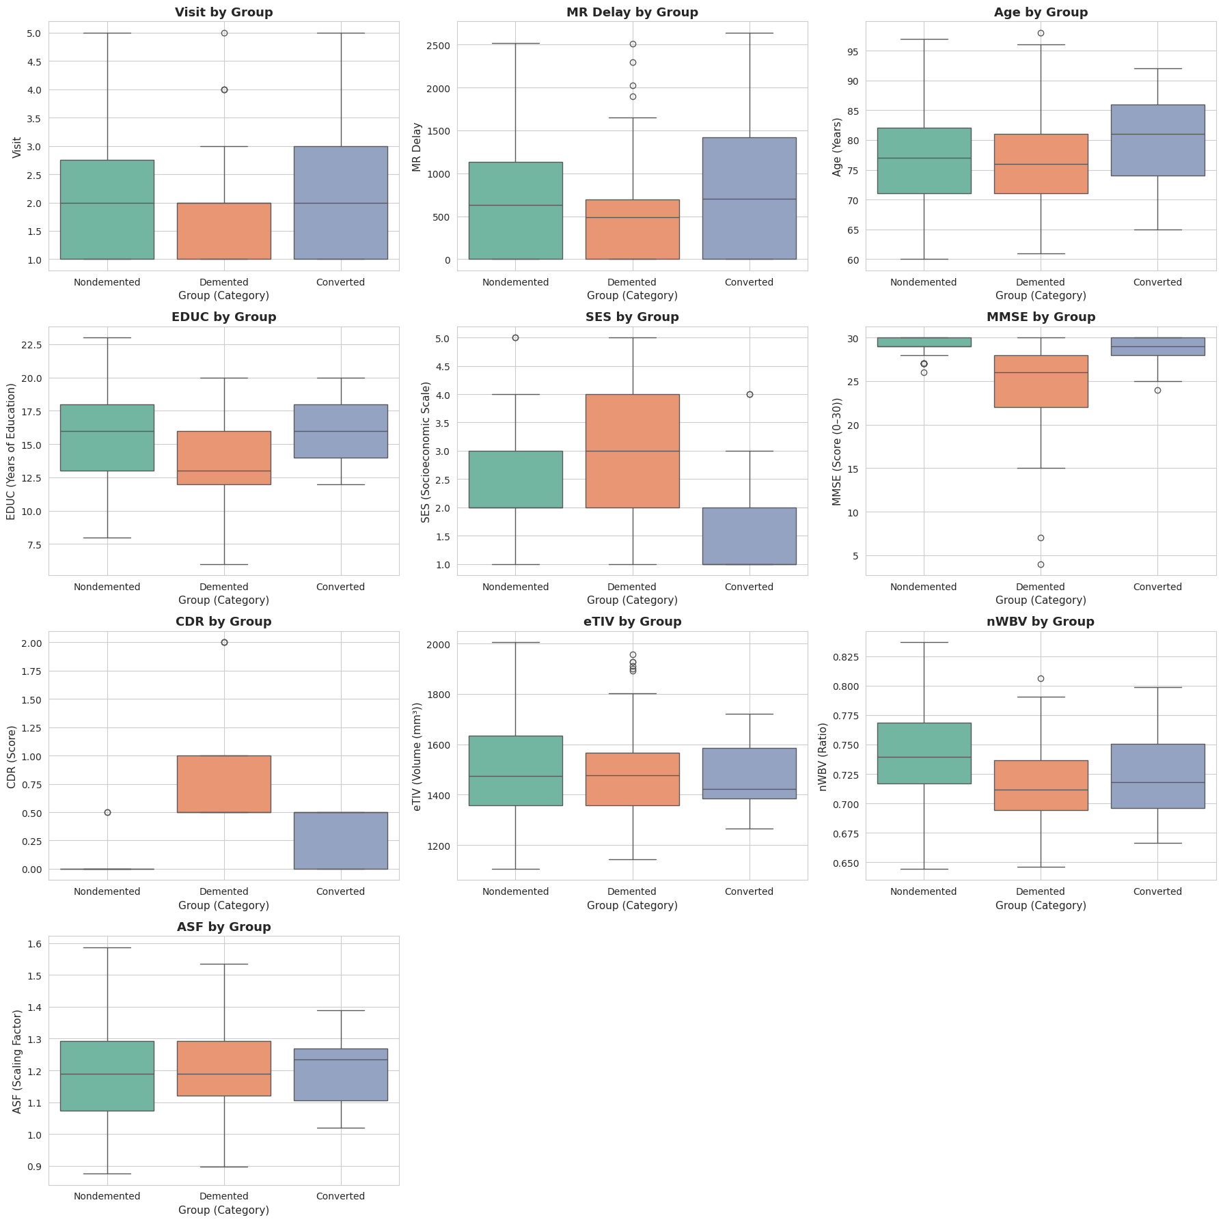
Data Exploration
Figure. 3. Box Plot of Potential Outliers.

Slide 10
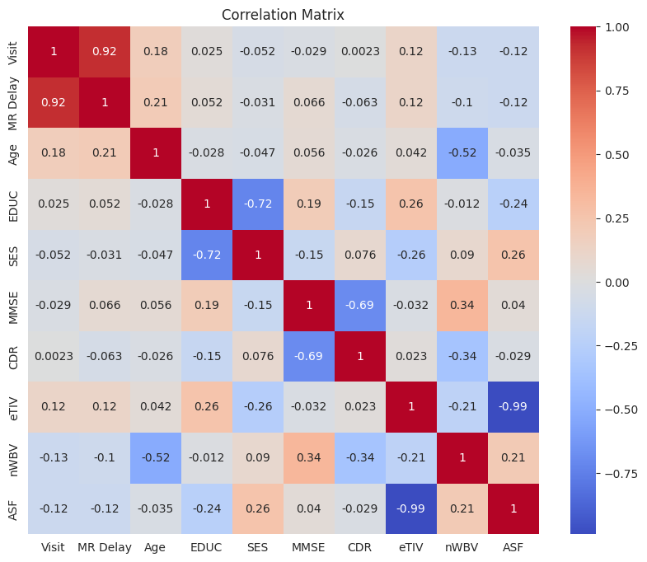
Data Exploration
MR Delay ↔ Visit: 0.92
→ very strong positive correlation
eTIV ↔ ASF: -0.99
→ almost perfect negative correlation
MMSE ↔ CDR: -0.69
→ moderately strong negative correlation
EDUC ↔ SES: -0.72
→ moderately strong negative correlation
Figure 4. Correlation table of OASIS-2 subjects’ demographic and clinical data.

Slide 11
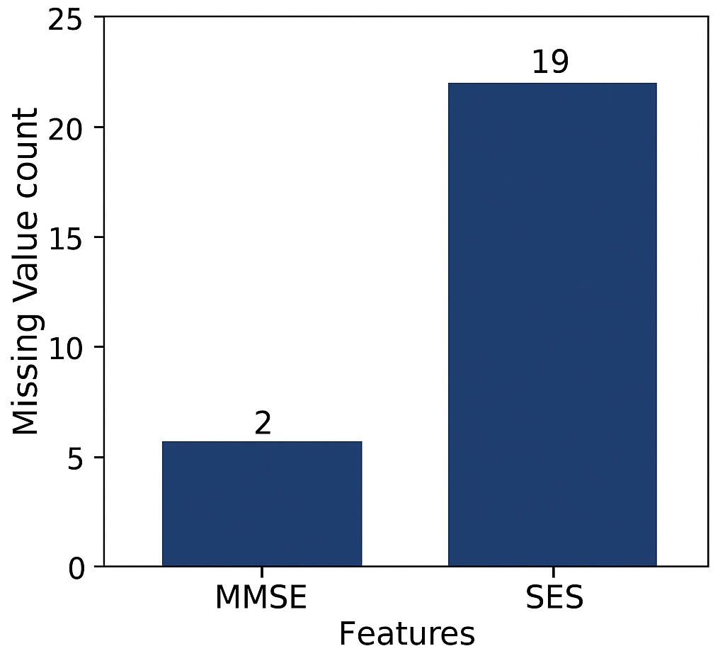
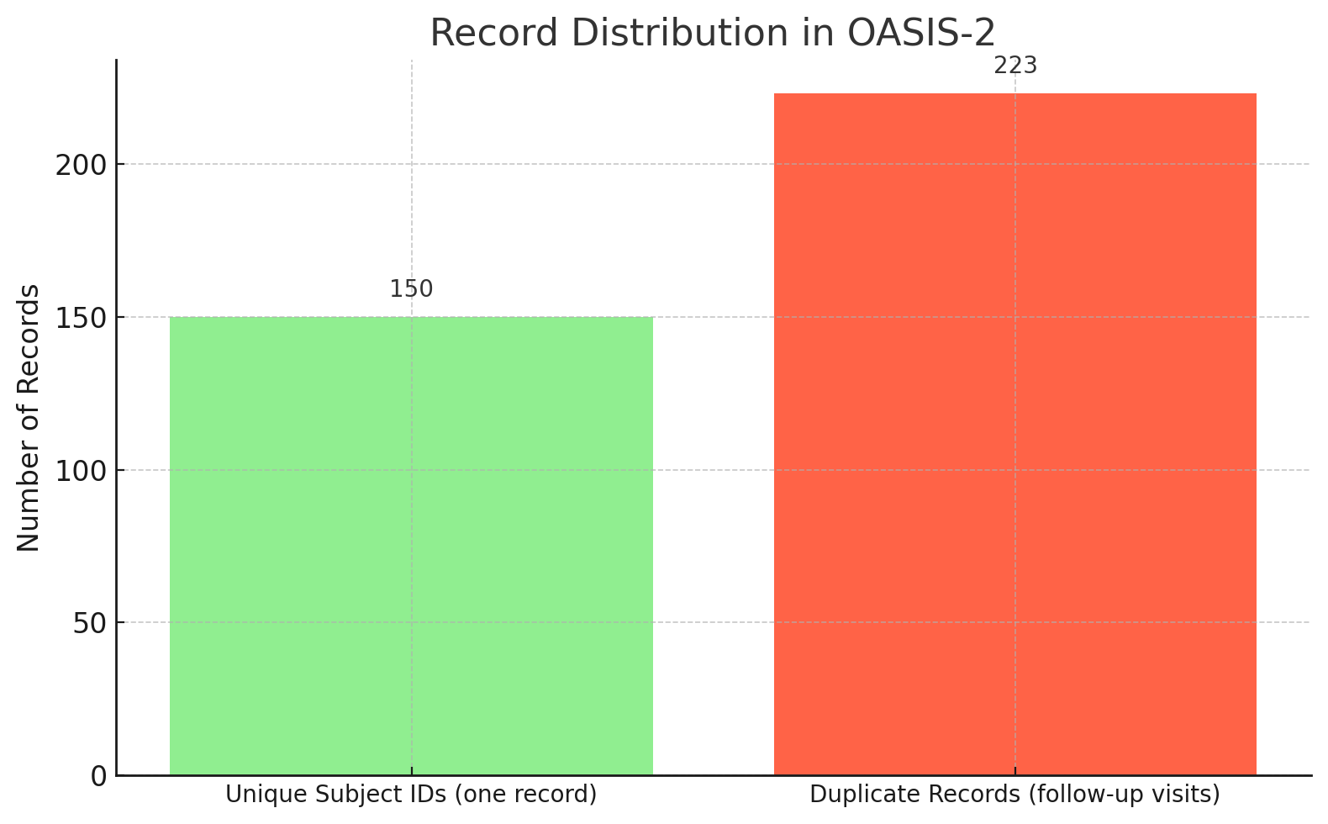
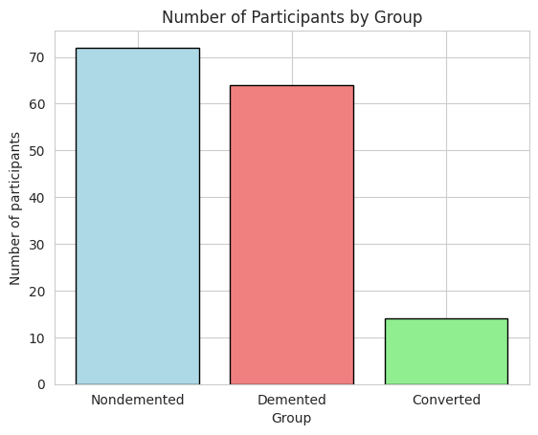
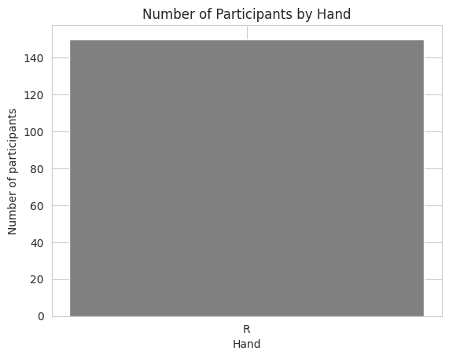
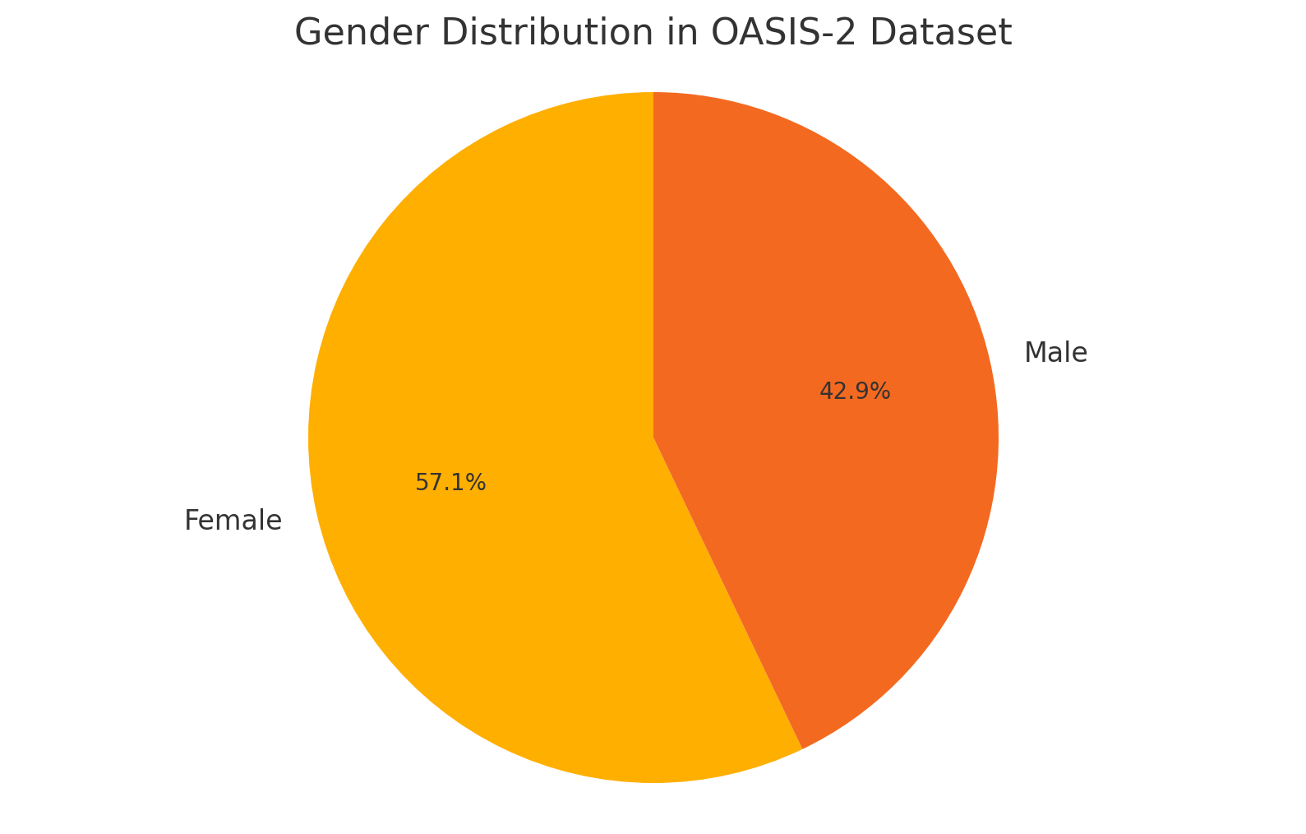
Data Preprocessing
1. Duplicate Subject IDs
2. Number of Visits are inconsistent
3. Missing values³
4. Three different groups
5. Unequal distribution of sex
6. Only Right-handed subjects
Notes:
Female have higher percentage of AD then male and that is the real world case

Slide 12
Feature Selection
Dropped Features
Hand
Visits
MR Delay
SES
ASF
Final Features Selected
Sex
Age
Education
MMSE
CDR
nWBV
eTIV

Slide 13
Training Testing and Slitting
Final Dataset: Reduced from 373 to 142 records by keeping only the last visit per subject.
CDR binarized: 0 as (nondemented) and 0.5, 1, 1.5, 2 as (demented)
Normalization:
Used MinMaxScaler for numerical features
OneHotEncoder for categorical feature (M/F)
ColumnTransformer
Cross-validation: Models trained using 5-fold cross-validation
Data Split: Training (70%), Testing (15%) and Validation (15%)
Notes:
As you said results doesn’t matter so I just not want to talk about ok that much accuracy I got I would like to talk about more on my methodology and observations
A ColumnTransformer was used to preprocess the dataset. Numerical features such as Age and MMSE were normalized using MinMaxScaler, while categorical features like Sex were encoded using OneHotEncoder. This ensured appropriate preprocessing without data leakage, enabling smooth integration into machine learning pipelines

Slide 14
Machine Learning Models
Logistic Regression^{4, 9}
SVM^{5, 3, 9, 10}
Random Forest^{6, 3, 9, 10}
AdaBoost^{7, 10}
XGBoost^{8, 3, 9, 10}
Justification: This models are mostly used by the researchers.

Slide 15
Results
Figure 5. Training, validation, testing accuracy of the models

Slide 16
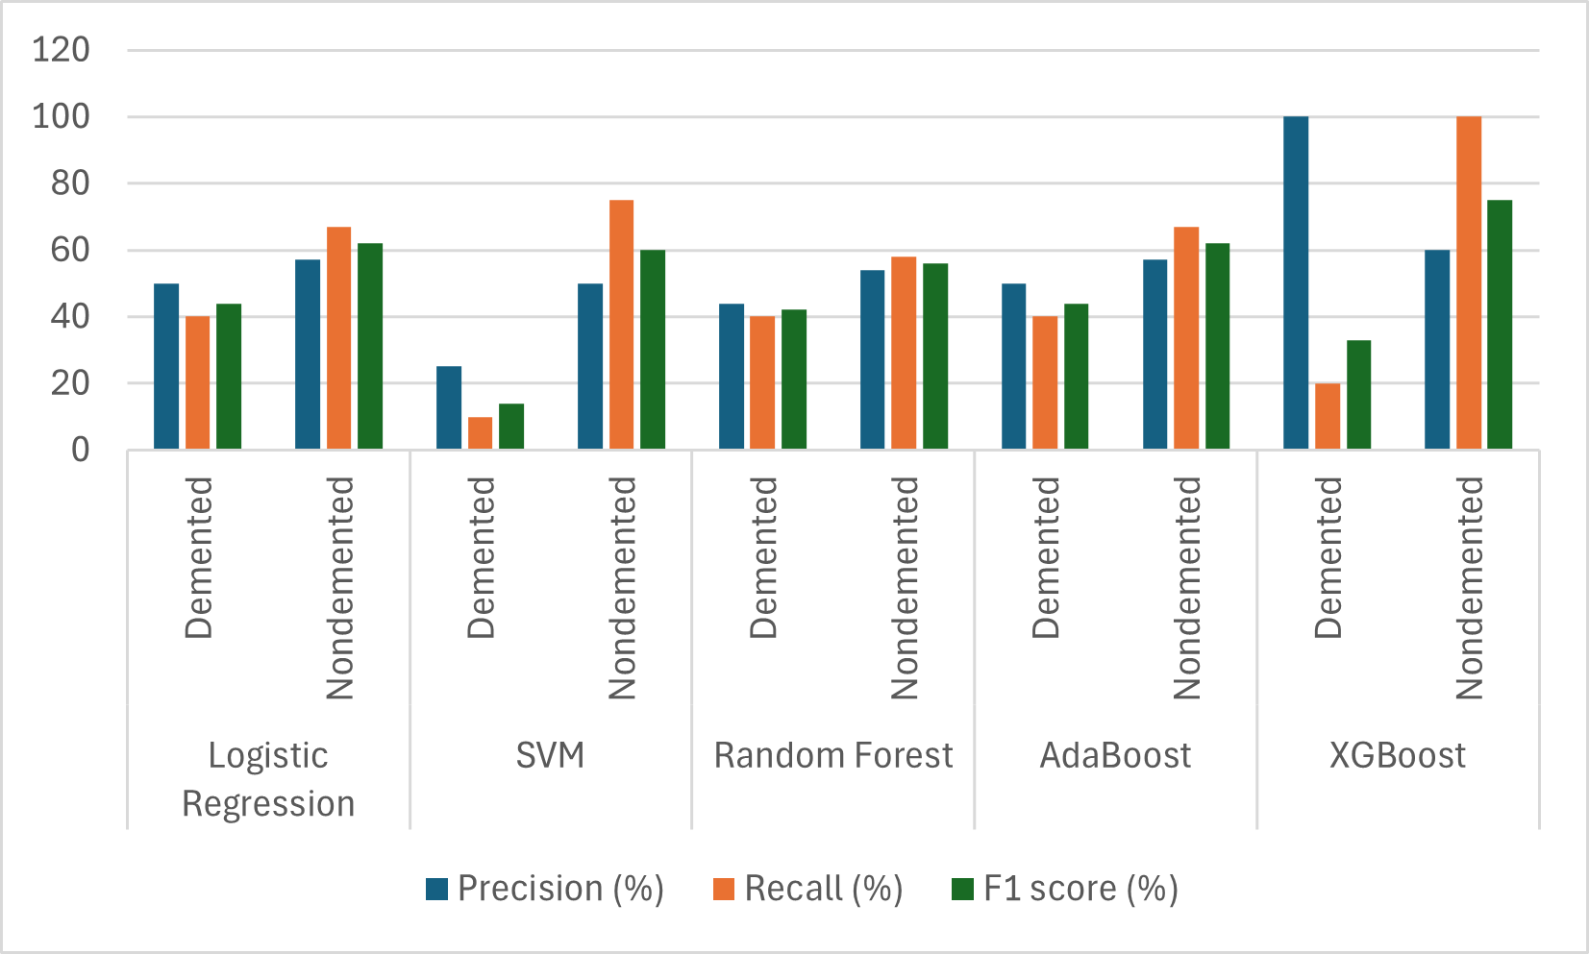
Results
Figure 6. Precision, Recall and F1 Score of the models.

Slide 17
Fairness Evaluation Metrics Used
Table 3. IBM’s AIF360 Fairness Evaluation Metric^{9,10}
S.No. | Fairness Metric | What it Measures
1. | Equal Opportunity Difference (EOD) | Disparity in true positive rates (TPR) between privileged and unprivileged groups.
2. | Average Odds Difference (AOD) | Average disparity in true positive rate (TPR) and false positive rate (FPR) between groups.
3. | Statistical Parity Difference (SPD) | Difference in positive prediction rates between unprivileged and privileged groups.
4. | Disparate Impact (DI) | Ratio outcomes of favorable between unprivileged privileged groups.
5. | Theil Index (TI) | Inequality in prediction distribution across individuals.

Slide 18
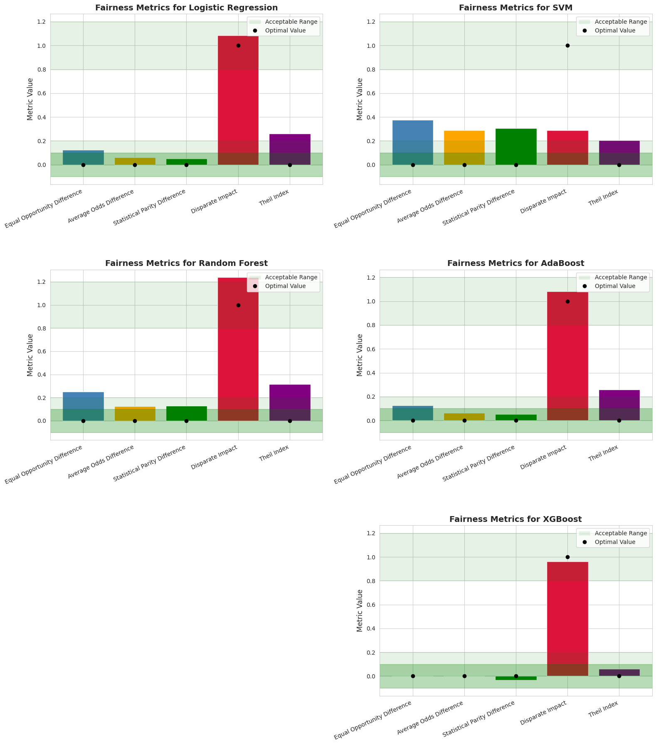
Fairness Metrics
Figure 7. Comparative Fairness Evaluation of ML Models Using AIF360 Metrics.^{9, 10, 11, 12, 13}
Notes:
XGBoost demonstrates the highest fairness among all models.
SVM shows strong bias, indicating it's the least suitable model from a fairness standpoint.
Other models fall in between, with AdaBoost and Logistic Regression providing a reasonable trade-off between performance and fairness.

Slide 19
Fairness Metrics Used
Table 4. Fairness results for various models on the OASIS-2 dataset
Metric | Ideal Value | Acceptable Threshold | Logistic Regression | Support Vector Machine | Random Forest | AdaBoost | XGBoost
Equal Opportunity Difference(EOD | 0 | [-0.1, 0.1] | 0.125 | 0.375 | 0.25 | 0.125 | 0
Average Odds Difference (AOD) | 0 | [-0.1, 0.1] | 0.0625 | 0.2875 | 0.125 | 0.0625 | 0
Statistical Parity Difference (SPD) | 0 | [-0.1, 0.1] | 0.0513 | 0.3077 | 0.1282 | 0.0513 | -0.0342
Disparate Impact (DI) | 1 | [0.8, 1.2] | 1.0833 | 1.4444 | 1.238 | 1.0833 | 0.963
Theil Index (TI) | 0 | [0, 0.25] | 0.2596 | 0.2044 | 0.3172 | 0.2596 | 0.0595
Score |  |  | 0.3221 | 1.4142 | 0.7412 | 0.3221 | 0.0712

Slide 20
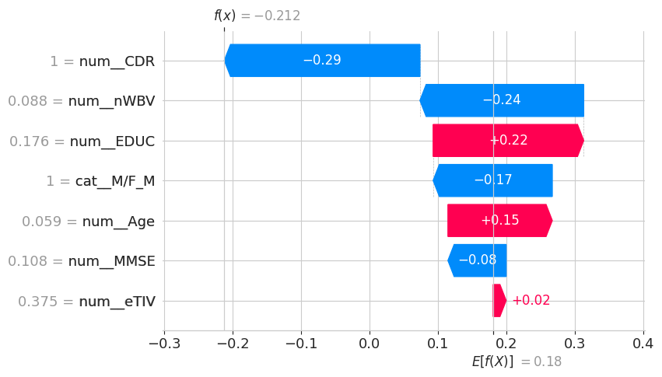
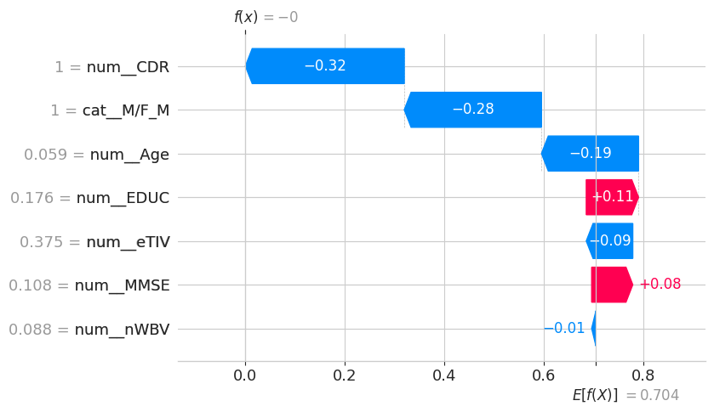
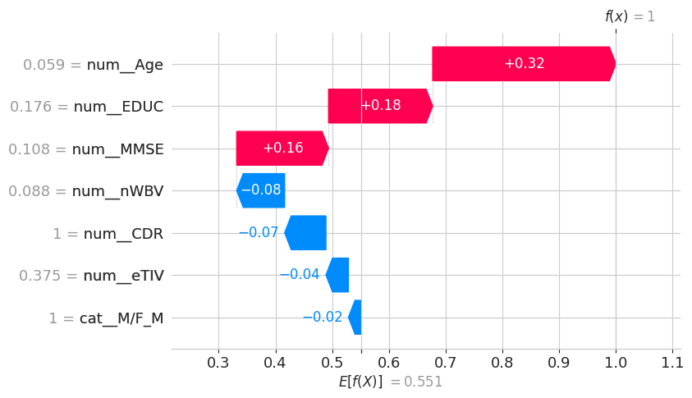
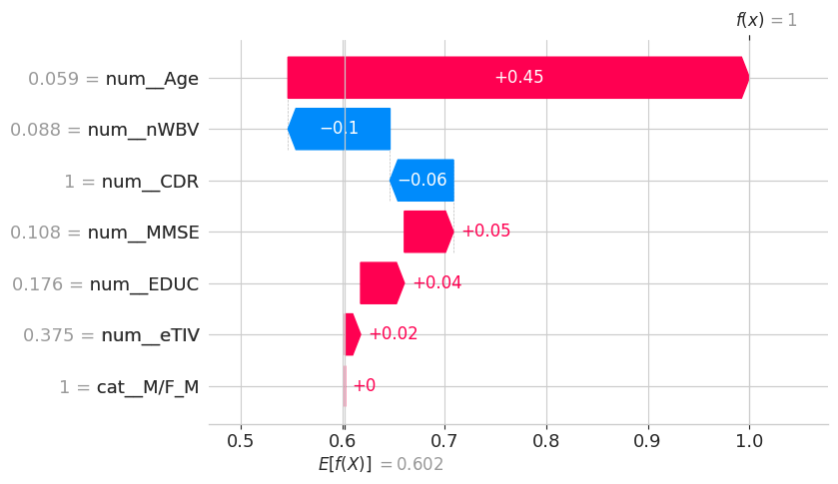
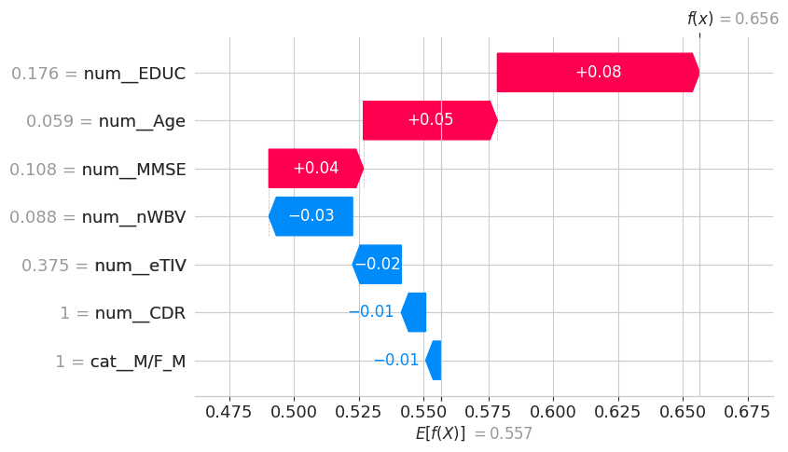
Explainability by SHAP
(a) Logistic Regression
(b) SVM
(c) Random Forest
(d) AdaBoost
(e) XGBoost
Figure. 8. SHAP waterfall plots for ML models^{16, 17, 18}
SHAP plot conclusion: Overall, AGE and EDUC consistently showed up as key positive drivers in predicting AD across all models, whereas nWBV and CDR values tended to reduce the likelihood of AD prediction.

Slide 21
Responsible AI consideration
Dataset: open access OASIS-2 dataset
Environment: Google Colab Notebook
ML Models used which are mostly used by researchers for reproducibility
Fairness evaluation: AIF360 fairness tool
Explainability: SHAP waterfall plot
GitHub Link of the code: https://github.com/MansiSinghal502/BMEN691

Slide 22
Conclusion
Key Findings
XGBoost achieved the highest accuracy among all models.
Trade off between Logistic Regression and AdaBoost. SVM get lowest accuracy and Random Forest overfitting.
Fairness and SHAP explainability provided insights into the reasons behind model predictions.
Significance
Promotes responsible AI via fairness and explainability.
Stresses early bias mitigation in healthcare AI.
Limitation
OASIS-2 dataset is small and imbalanced, especially for demented vs. nondemented classes.
Only right-handed data.
Future work
Use data augmentation to expand the dataset.
Continue work on bias mitigation techniques throughout the ML pipeline.

Slide 23
References
[1] World Health Organization. (2024, Mar.) Dementia. World Health Organization. Accessed: Apr. 10, 2025. [Online]. Available: https: //www.who.int/news-room/fact-sheets/detail/dementia
[2] D. S. Marcus, A. F. Fotenos, J. G. Csernansky, J. C. Morris, and R. L. Buckner, “Open Access Series of Imaging Studies: Longitudinal MRI Data in Nondemented and Demented Older Adults,” Journal of Cognitive Neuroscience, vol. 22, no. 12, pp. 2677–2684, Dec. 2010. [On line]. Available: https://direct.mit.edu/jocn/article/22/12/2677/4983/Open Access-Series-of-Imaging-Studies-Longitudinal
[3] S. Vinayak, E. Shahina, and A. Nayeemulla Khan, “Dementia prediction on oasis dataset using supervised and ensemble learning techniques,” Int. J. Eng. Adv. Technol, vol. 10, no. 1, pp. 244–254, 2020.
[4] M. P. LaValley, “Logistic regression,” Circulation, vol. 117, no. 18, pp.2395–2399, 2008.
[5] S. Vishwanathan and M. N. Murty, “Ssvm: a simple svm algorithm,”in Proceedings of the 2002 International Joint Conference on NeuralNetworks. IJCNN’02 (Cat. No. 02CH37290), vol. 3. IEEE, 2002, pp.2393–2398.
[6] S. J. Rigatti, “Random forest,” Journal of Insurance Medicine, vol. 47,no. 1, pp. 31–39, 2017.
[7] G. R¨atsch, T. Onoda, and K.-R. M¨uller, “Soft margins for adaboost,”Machine learning, vol. 42, pp. 287–320, 2001.
[8] S. Ramraj, N. Uzir, R. Sunil, and S. Banerjee, “Experimenting xgboostalgorithm for prediction and classification of different datasets,” Inter-national Journal of Control Theory and Applications, vol. 9, no. 40, pp.651–662, 2016.
[9] F. Dehghani, N. Malik, J. Lin, S. Bayat, and M. Bento, “Fairnessin healthcare: Assessing data bias and algorithmic fairness,” in 202420th International Symposium on Medical Information Processing andAnalysis (SIPAIM). IEEE, 2024, pp. 1–6
[10] S. Basheer, S. Bhatia, and S. B. Sakri, “Computational modelingof dementia prediction using deep neural network: analysis on oasisdataset,” IEEE access, vol. 9, pp. 42 449–42 462, 2021.
[11] J. A. Colquitt and J. B. Rodell, “Measuring justice and fairness,” TheOxford handbook of justice in the workplace, vol. 1, pp. 187–202, 2015.
[12] J. Yang, A. A. Soltan, D. W. Eyre, and D. A. Clifton, “Algorithmicfairness and bias mitigation for clinical machine learning with deepreinforcement learning,” Nature Machine Intelligence, vol. 5, no. 8, pp.884–894, 2023.
[13] J. Xu, Y. Xiao, W. H. Wang, Y. Ning, E. A. Shenkman, J. Bian,and F. Wang, “Algorithmic fairness in computational medicine,”EBioMedicine, vol. 84, 2022.
[14] SHAP Contributors. (2025, Apr.) Shap waterfall plot —shap latest documentation. SHAP. Accessed: Apr. 10, 2025.[Online]. Available: https://shap.readthedocs.io/en/latest/examplenotebooks/apiexamples/plots/waterfall.htm
[15] R. K. Bellamy, K. Dey, M. Hind, S. C. Hoffman, S. Houde, K. Kannan, P. Lohia, J. Martino, S. Mehta, A. Mojsilovi´ c et al., “Ai fairness 360: An extensible toolkit for detecting and mitigating algorithmic bias,” IBM Journal of Research and Development, vol. 63, no. 4/5, pp. 4–1, 2019.
[16] W. E. Marc´ılio and D. M. Eler, “From explanations to feature selection:assessing shap values as feature selection mechanism,” in 2020 33rdSIBGRAPI conference on Graphics, Patterns and Images (SIBGRAPI).Ieee, 2020, pp. 340–347.
[17] H. Wang, Q. Liang, J. T. Hancock, and T. M. Khoshgoftaar, “Feature se-lection strategies: a comparative analysis of shap-value and importance-based methods,” Journal of Big Data, vol. 11, no. 1, p. 44, 2024.
[18] Z. Li, “Extracting spatial effects from machine learning model using lo-cal interpretation method: An example of shap and xgboost,” Computers,Environment and Urban Systems, vol. 96, p. 101845, 2022.

Slide 24
ChatGPT Usage
S.No. | Prompt Used | ChatGPT Output
1. | Make the real world fig out of this text There are a number of works that employ machine learning (ML) algorithms such as logistic regression and random forest, which report high accuracy. However, much of the literature does not examine how such models operate in terms of decision-making and explainability. Instead, we focus on evaluating whether these AI models are fair and how their underlying decision-making process is performed and interpreted. | Motivation Figure generated shown in slide no. 4
2. | Why am I getting error while uploading my google colab notebook on github? | The repo name or path might be wrong, or the repo is private and Colab can't access it.

Slide 25
Thank You

